Slide 1
Practice Exam 1
MATH 1550 - Precalculus

Slide 2
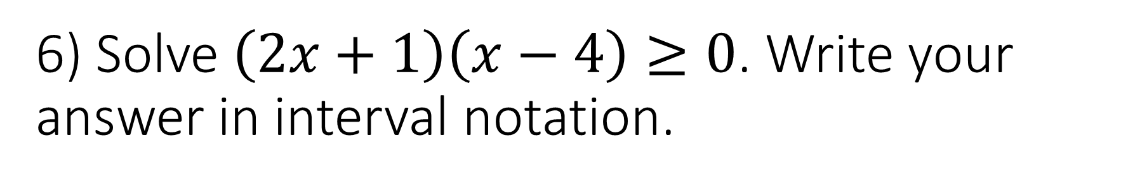
6) Solve $\left(2x+1\right)\left(x−4\right)≥0$. Write your answer in interval notation.

Slide 3
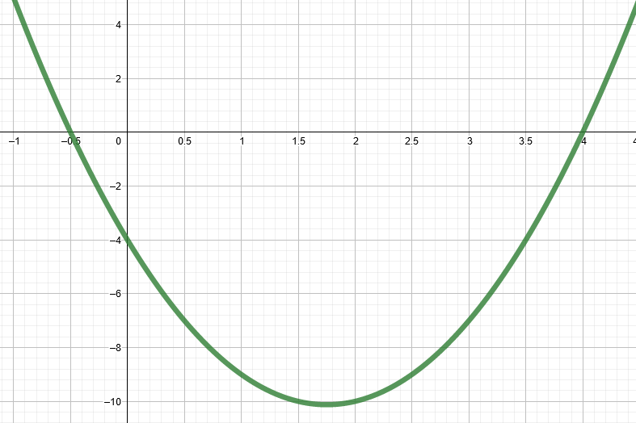

Slide 4
7) Find the distance of the line segment joining the two points (-1,0) and (4,5), and then find the midpoint of the line segment.

Slide 5
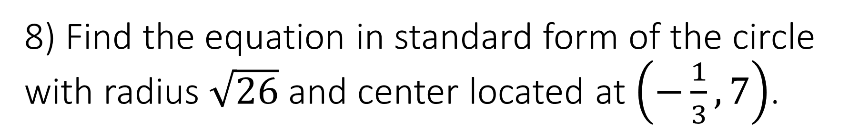
8) Find the equation in standard form of the circle with radius $\sqrt{26}$ and center located at $\left(−\frac{1}{3},7\right)$.

